Slide 1


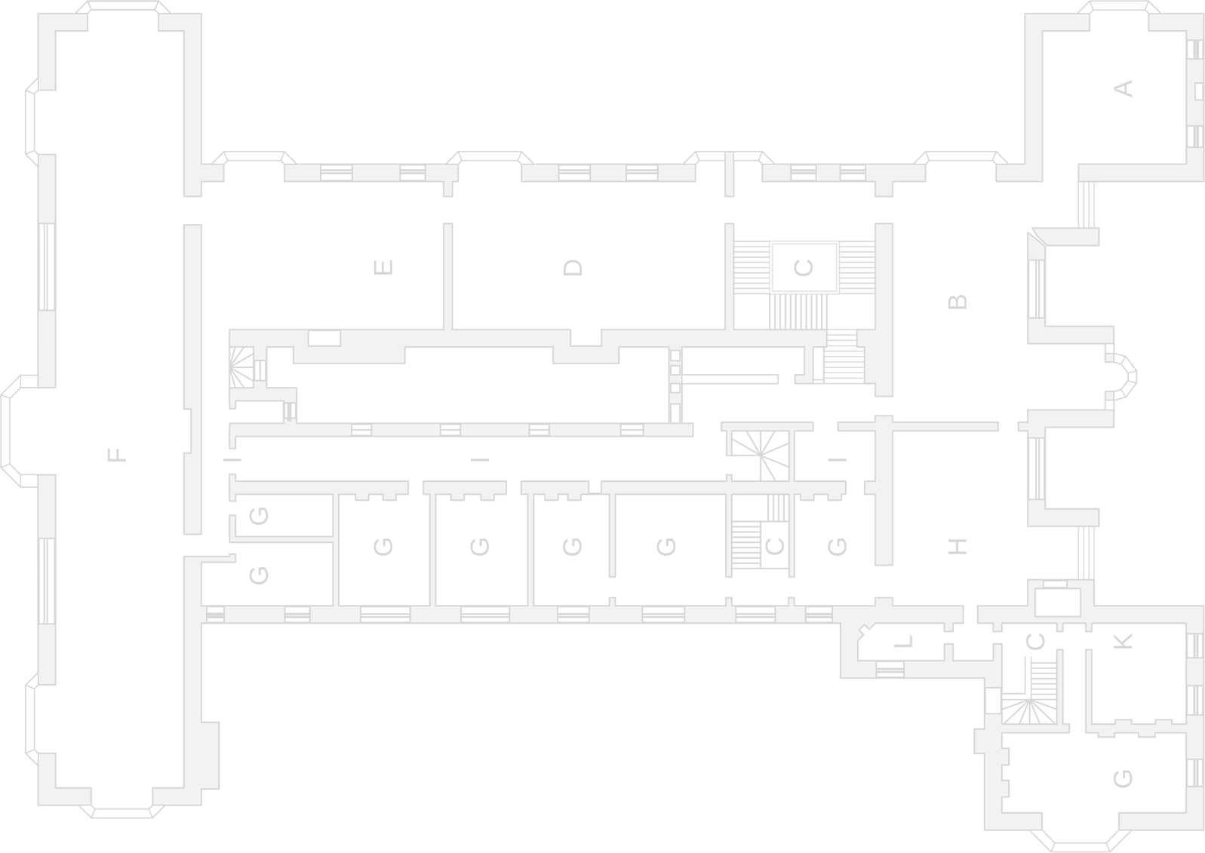

Types of networks
Representation of a local area network (LAN):
Representation of a wide area network (WAN):
Description of a local area network:
Description of a wide area network:
Computers that are not connected to a network are called standalone computers.
Notes:
Using copies of the images on the slide and lines representing cables, illustrate the concept of a LAN and a WAN.
Write three bullet points to describe a LAN.
Write three contrasting bullet points to describe a WAN.

Slide 2
The advantages and disadvantages of networks
The advantages of networks include:
The disadvantages of networks include:
Notes:
List the advantages of networks.
List the disadvantages of networks.

Slide 3






Factors that affect network performance
Number of users
Error rate
Transmission media
Bandwidth
Latency
Notes:
Explain how each of these five factors can impact network speed.

Slide 4

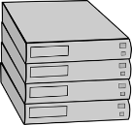

The different roles of computers in a client-server and a peer-to-peer network
Both local area networks and wide area networks can use either a client-server or a peer-to-peer approach when sharing data.
Logical connection
Notes:
Correctly label each illustration as either client-server or peer-to-peer.
Add additional labels to each illustration to indicate which devices are servers, clients or peers.
In the appropriate box underneath each illustration, explain what a server does, what a client does and what peers do.

Slide 5




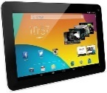

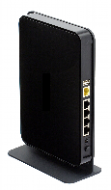


The internet
The internet is:
Google server
Internet service provider Domain name service
Request www.google.com
www.google.com → 8.8.8.8
Domain name service
Hosting
The cloud
Notes:
Define the internet.
Using the illustration as stimulus material, explain what is meant by a domain name service, hosting and the cloud.
Include advantages for users in your explanations.

Slide 6
Wired modes of connection – Ethernet
Ethernet is a used for communication on a
Ethernet has largely replaced competing wired LAN technologies.
The original Ethernet used while the newer Ethernet uses
with a to connect components together. Over the course of its history, Ethernet data transfer rates have increased from the original 2.94 megabits per second to 100 gigabits per second.
Systems communicating over Ethernet divide a stream of data into shorter pieces called
Each contains a and a used for error-checking so that damaged transmissions can be detected.
Ethernet provides networking protocols up to the of the open standards interconnection model.
Notes:
Research the Ethernet standard and fill in the blanks using the words:
source and destination address
switch
data link layer
standard for networking technologies
coaxial cable as a shared medium
frame
wired local area network
twisted pair and fibre optic links
cyclic redundancy check

